Slide 1
Declare valid IP
Valid IP: 37.235.24.53:44
Local IP: 100.100.100.11:22
UN: adibi | root
PW: Adibi.2030
GUI: username:elite/pw:Ad
Dns and name server record management
Declare valid ip with site name
Internal: host management like direct admin, Cpanel
or configure with os like windows server, Ubuntu, centos …
If ssh not activated:
Need a console to login
Like: command line, xshell
ssh un@ip|website
Or ssh <un>@<ip|website> –p <port>
To reset token: ssh-keygen -R 100.100.100.11
Diffrence between root and admin
Consider sudo or sudo –s
Systemctl
Systemctl status ssh

Slide 2
Create account in abr arvan or cloud flare:
https://www.cloudflare.com/
https://www.arvancloud.com/en
adibi.elite@gmail.com letMeSee!1
CDN https://whois.domaintools.com/
https://www.aapanel.com/index.html
wget -O install.sh http://www.aapanel.com/script/install-ubuntu_6.0_en.sh && sudo bash install.sh aapanel
aaPanel Internet Address: http://SERVER_IP:8888/6869aa54
aaPanel Internal Address: http://100.100.100.11:8888/6869aa54
username: dzzbb1ce
password: b82db4a8
Warning:
If you cannot access the panel,
release the following port (8888|888|80|443|20|21) in the security group

Slide 3
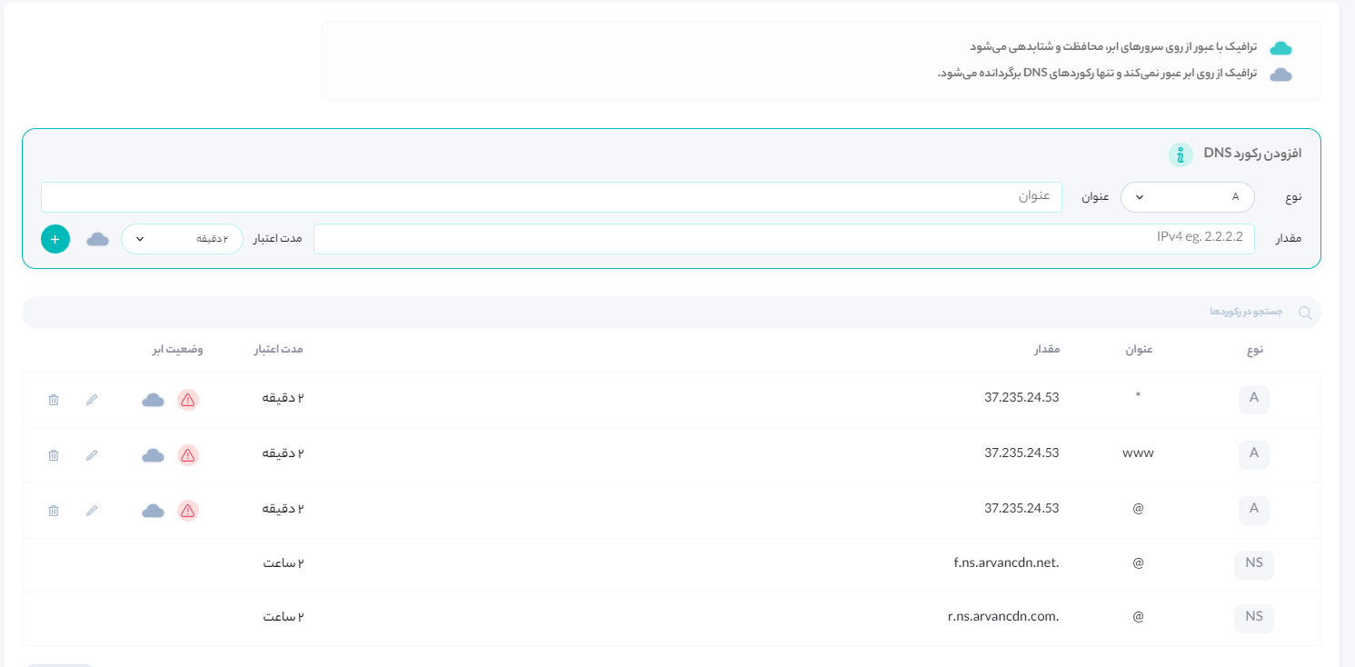
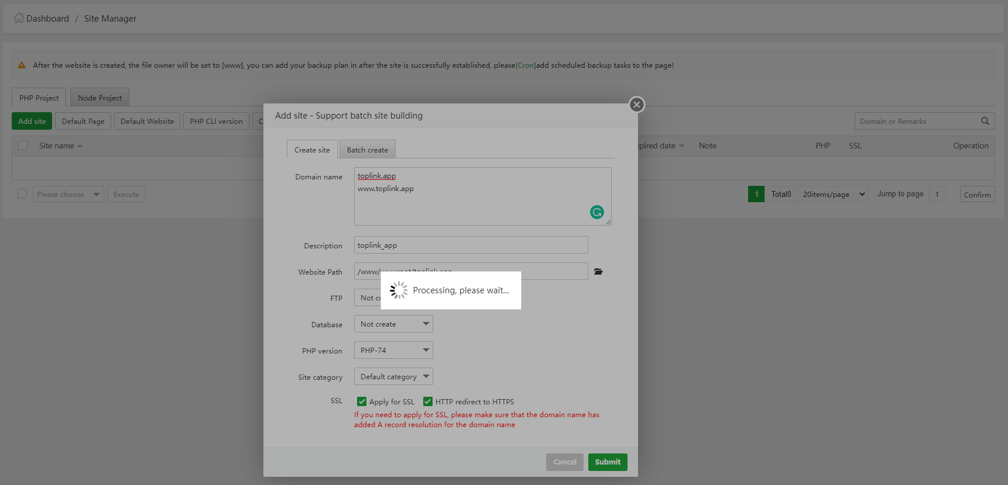

Slide 4
How To Install GitLab CE on Ubuntu 20.04 | 18.04
https://computingforgeeks.com/how-to-install-gitlab-ce-on-ubuntu-linux/
Step 1: Update system & install dependencies
sudo apt update
sudo apt upgrade –y
sudo apt install -y ca-certificates curl openssh-server
Step 2: Configure Postfix Send-Only SMTP Server
GitLab should be able to send emails to you on Git activities. Configure Postfix SMTP Server using the guide below:

Slide 5
Configure Postfix as a Send-Only SMTP Server on Ubuntu 22.04|20.04|18.04
Configure Postfix as a Send-Only SMTP Server on Ubuntu 22.04|20.04|18.04
Step 1: Update system & install dependencies
sudo apt update
sudo hostnamectl set-hostname mail.doanevis.com
sudo apt install mailutils
inet_interfaces = loopback-only

